Slide 1
Kecerdasan Komputasional
Kelas F

Slide 2
Agenda
Previous Week Assignments
Review of previous lectures
Intro to Decision Tree
Algoritma Hunt
Jenis-jenis Atribut
Cara mengukur Best-split
Algoritma Induksi Decision Tree
Contoh kasus: web-robot
Summary

Slide 3
Illustrating Classification Task
© Tan,Steinbach, Kumar Introduction to Data Mining 4/18/2004

Slide 4
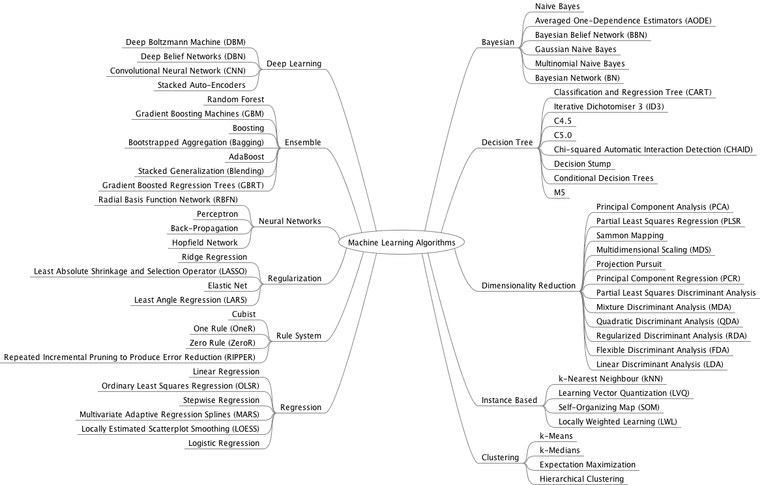
Mindmap By:
Dr. Jason Brownlee
2
4
1
5
3
Fuzzy Systems
6
Genetic Algorithms

Slide 5
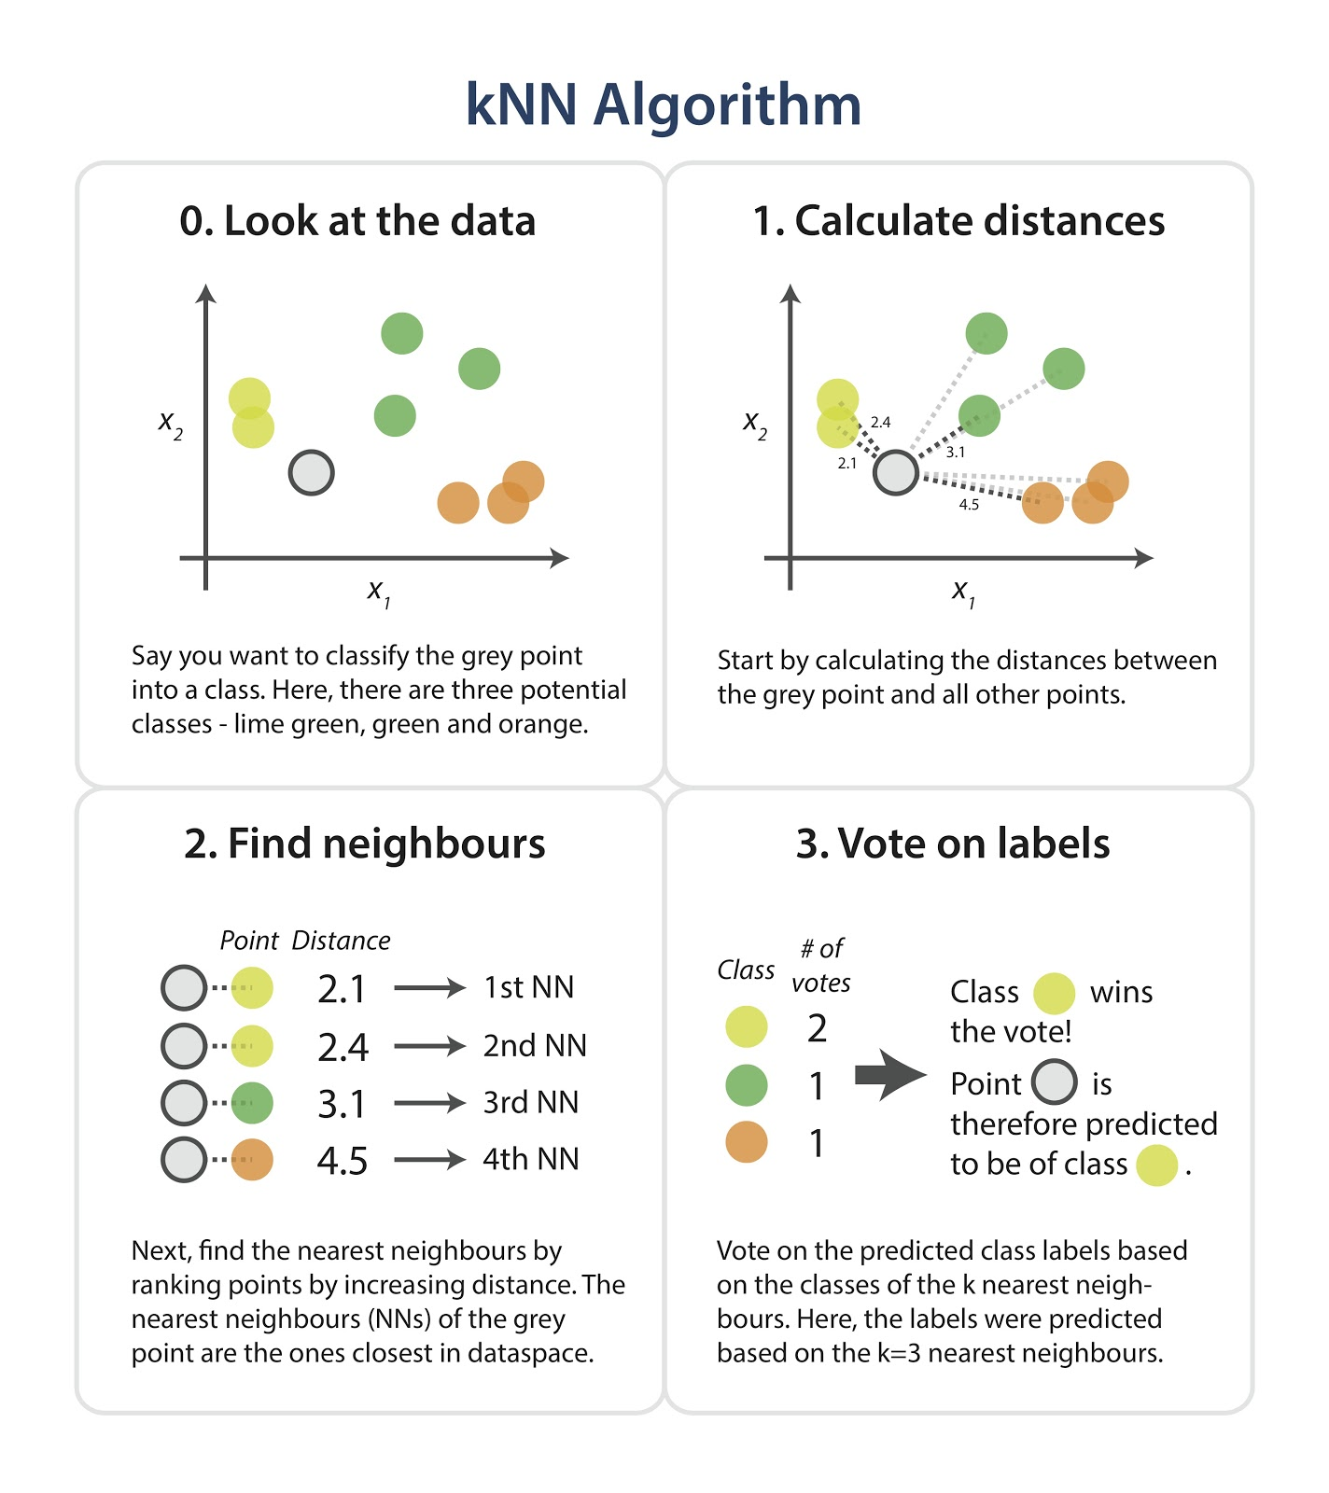

Slide 6
Nearest neighbor Classification…
k-NN classifiers are lazy learners
It does not build models explicitly
Unlike eager learners such as decision tree induction and rule-based systems
Classifying unknown records are relatively expensive

Slide 7
Tugas kNN
Buatlah sebuah program klasifikasi dengan metode k-nearest neighbor.
Program harus bisa membaca file dataset dari UCI machine learning databases:
https://archive.ics.uci.edu/ml/machine-learning-databases/spambase/
Gunakan metode pengukuran Cosine Similarity
Nilai K harus bisa bervariasi (menjadi parameter saat demo program)
Saat demo, data train dan test akan diberikan.
Setelah data train dan test diberikan, hitung nilai akurasi untuk data test dengan nilai K bervariasi, a.l: 1, 3, 5, 19.

Slide 8
Intro to Decision Tree

Slide 9
Example of a Decision Tree
categorical
categorical
continuous
class
Splitting Attributes
Home
Owner
Yes
No
NO
MarSt
Single, Divorced
Married
AnnInc
NO
< 80K
> 80K
NO
YES
Training Data
Model: Decision Tree

Slide 10
Another Example of Decision Tree
categorical
categorical
continuous
class
MarSt
Single, Divorced
Married
NO
Home Owner
Yes
No
NO
AnnInc
< 80K
> 80K
NO
YES
There could be more than one tree that fits the same data!

Slide 11
Decision Tree Classification Task
Decision Tree

Slide 12
Apply Model to Test Data
Test Data
Start from the root of tree.
Home Owner
Yes
No
NO
MarSt
Single, Divorced
Married
AnnInc
NO
< 80K
> 80K
NO
YES

Slide 13
Apply Model to Test Data
Test Data
Home Owner
Yes
No
NO
MarSt
Single, Divorced
Married
AnnInc
NO
< 80K
> 80K
NO
YES

Slide 14
Apply Model to Test Data
Test Data
Home Owner
Yes
No
NO
MarSt
Single, Divorced
Married
AnnInc
NO
< 80K
> 80K
NO
YES

Slide 15
Apply Model to Test Data
Test Data
Home Owner
Yes
No
NO
MarSt
Single, Divorced
Married
AnnInc
NO
< 80K
> 80K
NO
YES

Slide 16
Apply Model to Test Data
Test Data
Home Owner
Yes
No
NO
MarSt
Single, Divorced
Married
AnnInc
NO
< 80K
> 80K
NO
YES

Slide 17
Apply Model to Test Data
Test Data
Home Owner
Yes
No
NO
MarSt
Single, Divorced
Married
Assign Defaulted to “No”
AnnInc
NO
< 80K
> 80K
NO
YES

Slide 18
Decision Tree Classification Task
Decision Tree

Slide 19
Decision Tree Induction
Many Algorithms:
Hunt’s Algorithm (one of the earliest)
CART
ID3, C4.5
SLIQ,SPRINT

Slide 20
General Structure of Hunt’s Algorithm
Let D_{t} be the set of training records that reach a node t
General Procedure:
If D_{t} contains records that belong the same class y_{t}, then t is a leaf node labeled as y_{t}
If D_{t} is an empty set, then t is a leaf node labeled by the default class, y_{d}
If D_{t} contains records that belong to more than one class, use an attribute test to split the data into smaller subsets. Recursively apply the procedure to each subset.
D_{t}
?

Slide 21
Hunt’s Algorithm
Home Owner
Defaulted = No
Yes
No
Defaulted = No
Defaulted = Yes
Home Owner
Home Owner
Yes
No
Yes
No
Defaulted = No
Marital
Status
Defaulted = No
Marital
Status
Single,
Divorced
Single,
Divorced
Married
Married
Defaulted = Yes
Defaulted = No
Annual
Income
Defaulted = No
< 80K
>= 80K
Defaulted = No
Defaulted = Yes

Slide 22
Tree Induction
Greedy strategy.
Split the records based on an attribute test that optimizes certain criterion.
Issues
Determine how to split the records
How to specify the attribute test condition?
How to determine the best split?
Determine when to stop splitting

Slide 23
Tree Induction
Greedy strategy.
Split the records based on an attribute test that optimizes certain criterion.
Issues
Determine how to split the records
How to specify the attribute test condition?
How to determine the best split?
Determine when to stop splitting

Slide 24
How to Specify Test Condition?
Depends on attribute types
Nominal
Ordinal
Continuous
Depends on number of ways to split
2-way split
Multi-way split

Slide 25
Splitting Based on Nominal Attributes
Multi-way split: Use as many partitions as distinct values.
Binary split: Divides values into two subsets. Need to find optimal partitioning.
CarType
Family
Luxury
Sports
CarType
CarType
{Sports, Luxury}
OR
{Family, Luxury}
{Family}
{Sports}

Slide 26
Splitting Based on Ordinal Attributes
Multi-way split: Use as many partitions as distinct values.
Binary split: Divides values into two subsets. Need to find optimal partitioning.
What about this split?
Size
Small
Large
Medium
Size
Size
{Small, Medium}
OR
{Medium, Large}
{Large}
{Small}
Size
{Small, Large}
{Medium}

Slide 27
Splitting Based on Continuous Attributes
Different ways of handling
Discretization to form an ordinal categorical attribute
Static – discretize once at the beginning
Dynamic – ranges can be found by equal interval bucketing, equal frequency bucketing (percentiles), or clustering.
Binary Decision: (A < v) or (A ≥ v)
consider all possible splits and finds the best cut
can be more compute intensive

Slide 28
Splitting Based on Continuous Attributes

Slide 29
Tree Induction
Greedy strategy.
Split the records based on an attribute test that optimizes certain criterion.
Issues
Determine how to split the records
How to specify the attribute test condition?
How to determine the best split?
Determine when to stop splitting

Slide 30
How to determine the Best Split
Before Splitting: 10 records of class 0, 10 records of class 1
Which test condition is the best?

Slide 31
How to determine the Best Split
Greedy approach:
Nodes with homogeneous class distribution are preferred
Need a measure of node impurity:
Non-homogeneous,
High degree of impurity
Homogeneous,
Low degree of impurity

Slide 32
Measures of Node Impurity
Gini Index
Entropy
Misclassification error

Slide 33
How to Find the Best Split
Before Splitting:
M0
A?
B?
Yes
No
Yes
No
Node N1
Node N2
Node N3
Node N4
M1
M2
M3
M4
M12
M34
Gain = M0 – M12 vs M0 – M34

Slide 34
Measure of Impurity: GINI
Gini Index for a given node t :
(NOTE: p( j | t) is the relative frequency of class j at node t).
Maximum (1 - 1/n_{c}) when records are equally distributed among all classes, implying least interesting information
Minimum (0.0) when all records belong to one class, implying most interesting information

Slide 35
Examples for computing GINI
P(C1) = 0/6 = 0 P(C2) = 6/6 = 1
Gini = 1 – P(C1)² – P(C2)² = 1 – 0 – 1 = 0
P(C1) = 1/6 P(C2) = 5/6
Gini = 1 – (1/6)² – (5/6)² = 0.278
P(C1) = 2/6 P(C2) = 4/6
Gini = 1 – (2/6)² – (4/6)² = 0.444

Slide 36
Splitting Based on GINI
Used in CART, SLIQ, SPRINT.
When a node p is split into k partitions (children), the quality of split is computed as,
where, n_{i} = number of records at child i,
n = number of records at node p.

Slide 37
Binary Attributes: Computing GINI Index
Splits into two partitions
Effect of Weighing partitions:
Larger and Purer Partitions are sought for.
B?
Yes
No
Node N1
Node N2
Gini(N1) = 1 – (5/6)² – (2/6)² = 0.194
Gini(N2) = 1 – (1/6)² – (4/6)² = 0.528
Gini(Children) = 7/12 * 0.194 + 5/12 * 0.528 = 0.333

Slide 38
Categorical Attributes: Computing Gini Index
For each distinct value, gather counts for each class in the dataset
Use the count matrix to make decisions
Multi-way split
Two-way split
(find best partition of values)

Slide 39
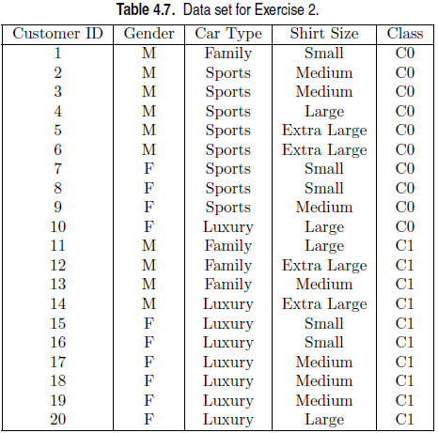
Exercises
Consider a binary classification problem with the following dataset:

Slide 40
Exercises
Compute the Gini index for the overall collection of training examples.
Node N1
Class=0
10
Class=1
10
Gini = 1 – (10/20)² – (10/20)² = 0.5

Slide 41
Exercises
Compute the Gini index for the Customer ID attribute.
Node N201: Gini = 1 – (1/1)²-(0/1)² = 0
Node N202: Gini = 0
…
Node N220: Gini = 0
Thus, the Gini index for the Customer ID attribute is 0.

Slide 42
Exercises
Compute the Gini index for the Gender attribute.
Gender M
C0=6
C1=4
Gini = 1 – (6/10)² – (4/10)² = 0.48
Gender F
C0=4
C1=6
Gini = 0.48
Gini = 10/20 * 0.48 + 10/20 * 0.48 = 0.48

Slide 43
Exercises
Compute the Gini index for the Car Type attribute using multiway split.
Family
C0=1
C1=3
Gini = 1 – (1/4)² – (3/4)² = 0.375
Sports
C0=8
C1=0
Gini = 1 – (8/8)² – (0/8)² = 0
Luxury
C0=1
C1=7
Gini = 1 – (1/8)² – (7/8)² = 0.21875
GINI = 4/20 * 0.375 + 8/20 * 0 + 8/20 * 0.21875 = 0.1625

Slide 44
Exercises
Compute the Gini index for the Shirt Size attribute using multiway split.
Small
C0=3, C1=2, Gini = 1 – (3/5)² – (2/5)² = 0.48
Medium
C0=3, C1=4, Gini = 1 – (3/7)² – (4/7)² = 0.49
Large
C0=2, C1=2, Gini = 1 – (2/4)² – (2/4)² = 0.5
Extra Large
C0=2, C1=2, Gini = 1 – (2/4)² – (2/4)² = 0.5
GINI = 5/20 * 0.48 + 7/20 * 0.49 + 4/20 * 0.5 + 4/20 * 0.5 = 0.4915

Slide 45
Exercises
Which attribute is better, Gender, Car Type, or Shirt Size?
GINIgender = 0.48
GINIcartype = 0.1625
GINIshirtsize = 0.4915
Thus, Car Type attribute is better
Explain why Customer ID should not be used as the attribute test condition even though it has the lowest Gini.

Slide 46
Continuous Attributes: Computing Gini Index
Use Binary Decisions based on one value
Several Choices for the splitting value
Number of possible splitting values = Number of distinct values
Each splitting value has a count matrix associated with it
Class counts in each of the partitions, A < v and A ≥ v
Simple method to choose best v
For each v, scan the database to gather count matrix and compute its Gini index
Computationally Inefficient! Repetition of work.

Slide 47
Continuous Attributes: Computing Gini Index...
For efficient computation: for each attribute,
Sort the attribute on values
Linearly scan these values, each time updating the count matrix and computing gini index
Choose the split position that has the least gini index
Sorted Values
Split Positions

Slide 48
Alternative Splitting Criteria based on INFO
Entropy at a given node t:
(NOTE: p( j | t) is the relative frequency of class j at node t).
Measures homogeneity of a node.
Maximum (log n_{c}) when records are equally distributed among all classes implying least information
Minimum (0.0) when all records belong to one class, implying most information
Entropy based computations are similar to the GINI index computations

Slide 49
Examples for computing Entropy
P(C1) = 0/6 = 0 P(C2) = 6/6 = 1
Entropy = – 0 log 0 – 1 log 1 = – 0 – 0 = 0
P(C1) = 1/6 P(C2) = 5/6
Entropy = – (1/6) log₂ (1/6) – (5/6) log₂ (1/6) = 0.65
P(C1) = 2/6 P(C2) = 4/6
Entropy = – (2/6) log₂ (2/6) – (4/6) log₂ (4/6) = 0.92

Slide 50
Splitting Based on INFO...
Information Gain:
Parent Node, p is split into k partitions;
n_{i} is number of records in partition i
Measures Reduction in Entropy achieved because of the split. Choose the split that achieves most reduction (maximizes GAIN)
Used in ID3 and C4.5
Disadvantage: Tends to prefer splits that result in large number of partitions, each being small but pure.

Slide 51
Splitting Based on INFO...
Gain Ratio:
Parent Node, p is split into k partitions
n_{i} is the number of records in partition i
Adjusts Information Gain by the entropy of the partitioning (SplitINFO). Higher entropy partitioning (large number of small partitions) is penalized!
Used in C4.5
Designed to overcome the disadvantage of Information Gain

Slide 52
Splitting Criteria based on Classification Error
Classification error at a node t :
Measures misclassification error made by a node.
Maximum (1 - 1/n_{c}) when records are equally distributed among all classes, implying least interesting information
Minimum (0.0) when all records belong to one class, implying most interesting information

Slide 53
Examples for Computing Error
P(C1) = 0/6 = 0 P(C2) = 6/6 = 1
Error = 1 – max (0, 1) = 1 – 1 = 0
P(C1) = 1/6 P(C2) = 5/6
Error = 1 – max (1/6, 5/6) = 1 – 5/6 = 1/6
P(C1) = 2/6 P(C2) = 4/6
Error = 1 – max (2/6, 4/6) = 1 – 4/6 = 1/3

Slide 54
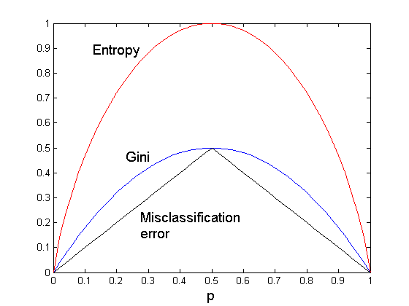
Comparison among Splitting Criteria
For a 2-class problem:

Slide 55
Misclassification Error vs Gini
A?
Yes
No
Node N1
Node N2
Gini(N1) = 1 – (3/3)² – (0/3)² = 0
Gini(N2) = 1 – (4/7)² – (3/7)² = 0.489
Gini(Children) = 3/10 * 0 + 7/10 * 0.489 = 0.342
Gini improves !!

Slide 56
Tree Induction
Greedy strategy.
Split the records based on an attribute test that optimizes certain criterion.
Issues
Determine how to split the records
How to specify the attribute test condition?
How to determine the best split?
Determine when to stop splitting

Slide 57
Stopping Criteria for Tree Induction
Stop expanding a node when all the records belong to the same class
Stop expanding a node when all the records have similar attribute values
Early termination (to be discussed later)

Slide 58
Decision Tree Based Classification
Advantages:
Inexpensive to construct
Extremely fast at classifying unknown records
Easy to interpret for small-sized trees
Accuracy is comparable to other classification techniques for many simple data sets

Slide 59
Example: C4.5
Simple depth-first construction.
Uses Information Gain
Sorts Continuous Attributes at each node.
Needs entire data to fit in memory.
Unsuitable for Large Datasets.
Needs out-of-core sorting.
You can download the software from: http://www.cse.unsw.edu.au/~quinlan/c4.5r8.tar.gz

Slide 60
Exercises
No. 7

Slide 61
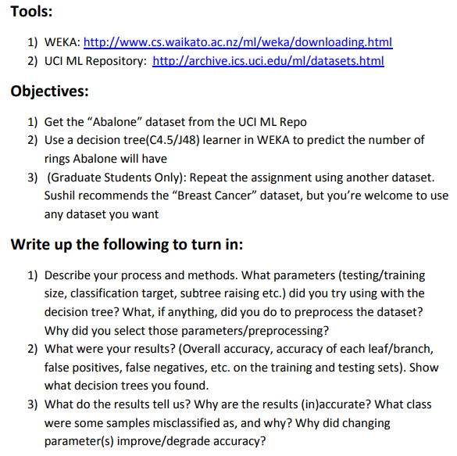
Tugas DT

